Slide 1
Cryptographic Hash Function
KEY POINTS
◆ A hash function maps a variable-length message into a fixed-length hash value, or message digest.
◆ Virtually all cryptographic hash functions involve the iterative use of a compression function.
◆ The compression function used in secure hash algorithms falls into one of two categories: a function specifically designed for the hash function or an
algorithm based on a symmetric block cipher.
SHA and Whirlpool are examples of these two approaches, respectively.

Slide 2
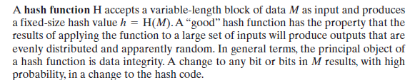
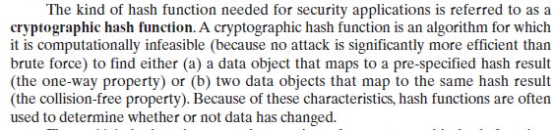

Slide 3
Figure depicts the general operation of a cryptographic hash function.
Typically, the input is padded out to an integer multiple of some fixed length (e.g., 1024 bits), and the padding includes the value of the length of the original message in bits.
The length field is a security measure to increase the difficulty for an attacker to produce an alternative message with the same hash value.

Slide 4
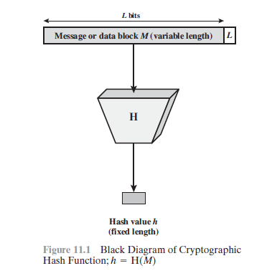

Slide 5
Applications
Perhaps the most versatile cryptographic algorithm is the cryptographic hash function.
It is used in a wide variety of security applications and Internet protocols. To better understand some of the requirements and security implications for cryptographic hash functions, it is useful to look at the range of applications in which it is employed.
Message Authentication
Message authentication is a mechanism or service used to verify the integrity of a message. Message authentication assures that data received are exactly as sent (i.e., contain no modification, insertion, deletion, or replay). In many cases, there is a requirement that the authentication mechanism assures that purported identity of the sender is valid.
When a hash function is used to provide message authentication,
the hash function value is often referred to as a message digest.

Slide 6
More commonly, message authentication is achieved using a message authentication code (MAC), also known as a keyed hash function. Typically, MACs are used between two parties that share a secret key to authenticate information exchanged between those parties.
A MAC function takes as input a secret key and a data block and produces a hash value, referred to as the MAC.
This can then be transmitted with or stored with the protected message. If the integrity of the message needs to be checked, the MAC function can be applied to the message and the result compared with the stored MAC value.
An attacker who alters the message will be unable to alter
the MAC value without knowledge of the secret key.
Note that the verifying party also knows who the sending party is because no one else knows the secret key.

Slide 7
Digital Signatures
Another important application, which is similar to the message authentication application, is the digital signature. The operation of the digital signature is similar to that of the MAC.
In the case of the digital signature, the hash value of a message is encrypted with a user’s private key. Anyone who knows the user’s public key can verify the integrity of the message that is associated with the digital signature.
In this case, an attacker who wishes to alter the message would need to know the user’sprivate key.

Slide 8
in a simplified fashion, how a hash code is used to
provide a digital signature.
a. The hash code is encrypted, using public-key encryption with the sender’s private key
It also provides a digital signature, because only the sender could have produced the encrypted hash code.
In fact, this is the essence of the digital signature technique.
b. If confidentiality as well as a digital signature is desired, then the message plus the private-key-encrypted hash code can be encrypted using a symmetric secret key.
This is a common technique.

Slide 9
Other Applications
Hash functions are commonly used to create a one-way password file.
Hash functions can be used for intrusion detection and virus detection.
A cryptographic hash function can be used to construct a pseudorandom function (PRF) or a pseudorandom number generator (PRNG).

Slide 10
MD-4
MD4 is a one-way hash function designed by Ron Rivest.
MD stands for MessageDigest;
the algorithm produces a 128-bit hash, or message digest, of the input message.
In [1319], Rivest outlined his design goals for the algorithm:
Security. It is computationally infeasible to find two messages that hashed to the same value. No attack is more efficient than brute force.
Direct Security. MD4’s security is not based on any assumption, like the difficulty of factoring.

Slide 11
Speed. MD4 is suitable for high-speed software implementations. It is based on a simple
set of bit manipulations on 32-bit operands.
Simplicity and Compactness. MD4 is as simple as possible, without large data structures or
a complicated program.
Favor Little-Endian Architectures. MD4 is optimized for microprocessor architectures
(specifically Intel microprocessors); larger and faster computers make any necessary translations.

Slide 12
After the algorithm was first introduced, Bert den Boer and Antoon Bosselaers successfully
cryptanalyzed the last two of the algorithm’s three rounds .
In an unrelated cryptanalytic result, Ralph Merkle successfully attacked the first two rounds.
Eli Biham discussed a differential cryptanalysis attack against the first two rounds of MD4.
Even though these attacks could not be extended to the full algorithm, Rivest strengthened the algorithm. The result is MD5.

Slide 13
MD5
MD5 is an improved version of MD4 .
Although more complex than MD4, it is similar in
design and also produces a 128-bit hash.
Description of MD5
After some initial processing, MD5 processes the input text in 512-bit blocks, divided into 16 32-bit
sub-blocks.
The output of the algorithm is a set of four 32-bit blocks, which concatenate to form a single 128-bit hash value.

Slide 14
First, the message is padded so that its length is just 64 bits short of being a multiple of 512.
This padding is a single 1-bit added to the end of the message, followed by as many zeros as are required.
Then, a 64-bit representation of the message’s length (before padding bits were added) is appended to the result.
These two steps serve to make the message length an exact multiple of 512 bits in length (required for the rest of the algorithm), while ensuring that different messages will not look the same after padding.
Four 32-bit variables are initialized:
A = 0x01234567
B = 0x89abcdef
C = 0xfedcba98
D = 0x76543210
These are called chaining variables.

Slide 15
Now, the main loop of the algorithm begins. This loop continues for as many 512-bit blocks as are in the message.
The four variables are copied into different variables: a gets A, b gets B, c gets C, and d gets D.
The main loop has four rounds (MD4 had only three rounds), all very similar.
Each round uses a different operation 16 times. Each operation performs a nonlinear function on three of a, b, c, and d.
Then it adds that result to the fourth variable, a sub-block of the text and a constant.
Then it rotates that result to the right a variable number of bits and adds the result to one of a, b, c, or d. Finally the result replaces one of a, b, c, or d. See Figures

Slide 16
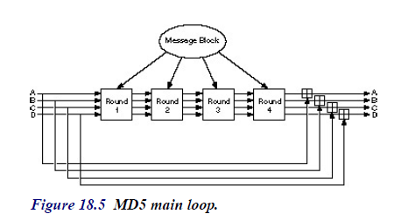

Slide 17
F(X,Y,Z) = (X AND Y) V ((¬ X) AND Z)
G(X,Y,Z) = (X AND Z) V (Y AND (¬ Z))
H(X,Y,Z) = X XOR Y XOR Z
I(X,Y,Z) = Y XOR (X V (¬ Z))
( is XOR, is AND, is OR, and ¬ is NOT.)
These functions are designed so that if the corresponding bits of X, Y, and Z are independent and unbiased, then each bit of the result will also be independent and unbiased. The function F is the bitwise conditional: If X then Y else Z. The function H is the bit-wise parity operator.

Slide 18
These functions are designed so that if the corresponding bits of X, Y, and Z are independent and unbiased, then each bit of the result will also be independent and unbiased.
The function F is the bitwise conditional: If X then Y else Z. The function H is the bit-wise parity operator.

Slide 19
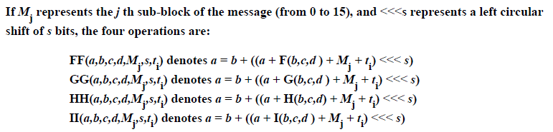

Slide 20
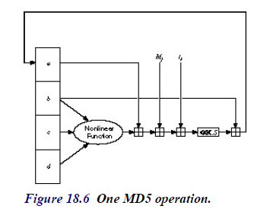

Slide 21

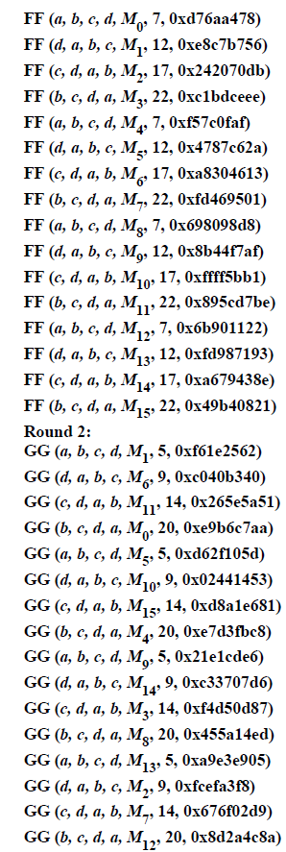

Slide 22
